Slide 1

Data Visualization Workshop
By Uzma Ali
16-Sept-2017

Slide 2
Agenda
Motivation for this workshop
Power of Data Visualization
Dashboards
DEMO

Slide 3
Motivation for this Workshop

Slide 4
Motivation
Make Data Talk
Turn Data into Valuable Information
Create Interactive dashboard

Slide 5

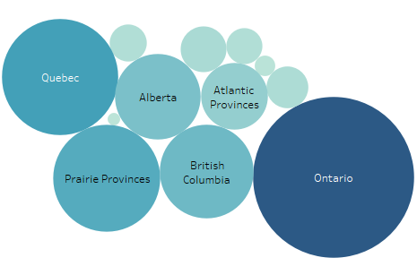
Make Data Talk
The gradient of the color represents higher value
Mental health services, professional consultation/service used, 12 months – Number of Persons
Data : Canadian Community Health Survey (CCHS)
Notes:
The motivation of this workshop is to help make data talk.
On this slide, you see a visualization from the Mental Health Profile, Canadian Community Health Survey (CCHS) The colors represent the provinces. Ontario, Quebec and Prarie Province lead in the numbers before British Columbia.

Slide 6
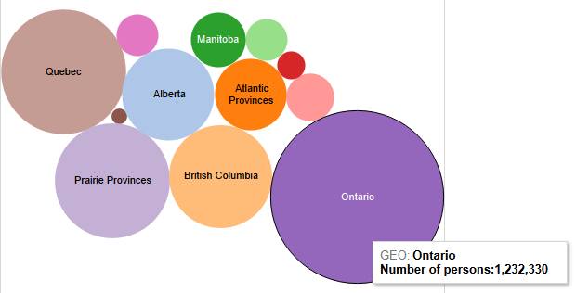
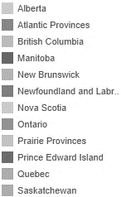
Make Data Talk
Size of the bubble represents the key value
Number of Persons
Mental health services, professional consultation/service used, 12 months
Data : Canadian Community Health Survey (CCHS)
Notes:
Here the size of the circle is being used to represent the number of people who took mental health professional services in the last 12 months.

Slide 7
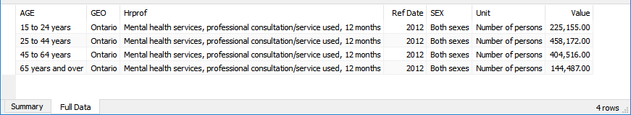
Make Data Talk
Its all in the details
Mental health services, professional consultation/service used, 12 months
Data : Canadian Community Health Survey (CCHS)

Slide 8
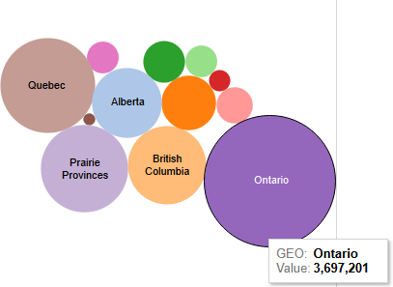
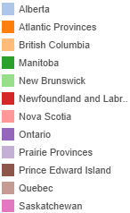


Make Data Talk
Tooltip helps make data interactive
Number of Persons
Mental health services, professional consultation/service used, 12 months
Data : Canadian Community Health Survey (CCHS)

Slide 9
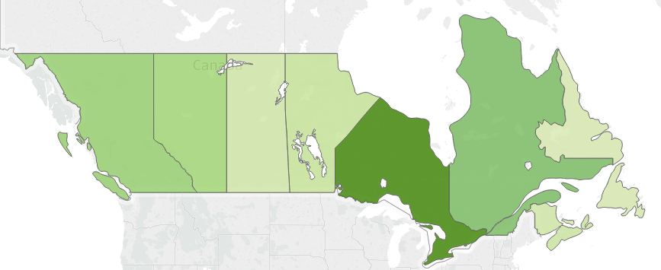
Make Data Talk
Visualizing data on the map brings a location perspective.
Mental health services, professional consultation/service used, 12 months
Data : Canadian Community Health Survey (CCHS)
Notes:
Data is from the Mental Health Profile, Canadian Community Health Survey (CCHS)

Slide 10
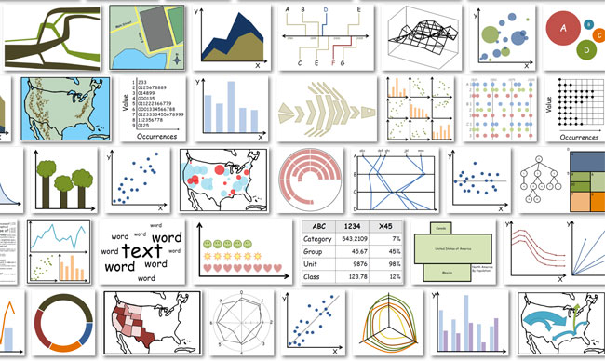
Make Data Talk
Possibilities are endless!
Notes:
In the previous slides, we saw color, size and geographical locations as 3 different elements used in the visualizations. But reality is that possibilities are endless.
Word Cloud, Scatter Charts, Tree Maps, 3D charts along with size and color can bring immense value to data.

Slide 11


Power of Data Visualization

Slide 12
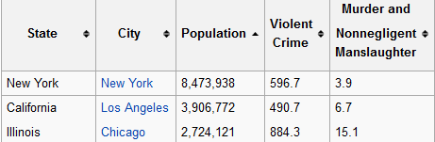
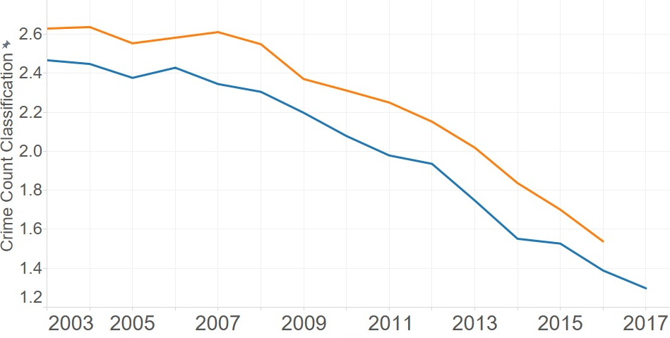
How Safe is Chicago?
–We predict that crimes will decrease in the coming years. Some communities may see this decline more than others
CHICAGO FACTS
– Third Most Populous City in the United States
– Highest Crime and Homicide rate in US
Simon Fraser University
Summer Months
–Crimes are more prevalent in summer than winter. The police vigilance can be focused more during the summer times
Winter Months
Notes:
I participated in a project “How Safe is Chicago?” as a team effort for the Professional Masters in Big Data Program at SFU. What do you gather from this line chart?
We predict that crimes will decrease in the coming years. Some communities may see this decline more than others
Crimes are more prevalent in summer than winter. The police vigilance can be focused more during the summer times

Slide 13
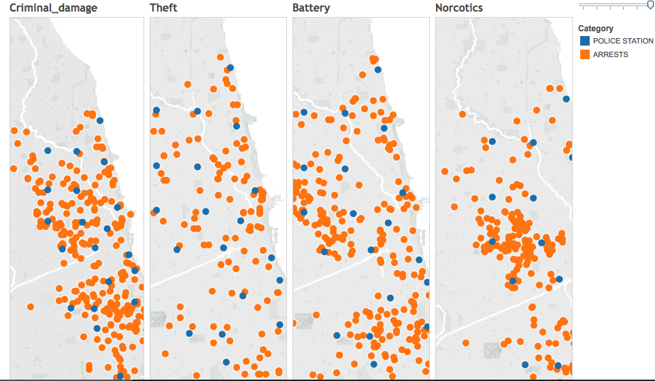
How Safe is Chicago?
–We recommend placing police stations in the communities, where the crime rate is increasing or steady
Simon Fraser University
Notes:
–We recommend placing police stations in the communities, where the crime rate is increasing or steady

Slide 14
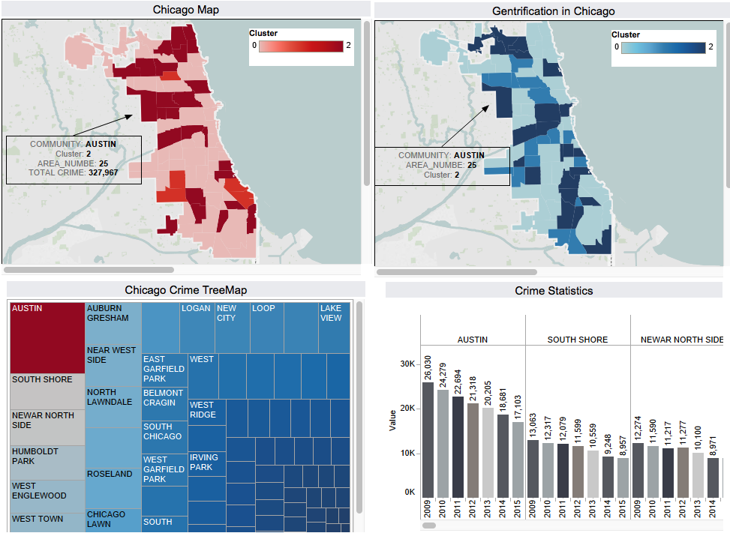
A picture is worth a thousand words
Simon Fraser University
Community Area: Austin
 | Actual | Average
Below Poverty Level | 27% | 20%
Crowded Housing | 5.7% | 4.8%
No High School Diploma | 25% | 21%
Unemployment | 21% | 13%
Per Capita Income | 15290 | 25005
Hardship Index | 73 | 49.9
Gentrification Index | -16
Notes:
A picture is worth a thousand words. Here the map is clustered by number and type of crimes vs Gentrification index. Some neighbourhoods get highlighted on both the maps.

Slide 15
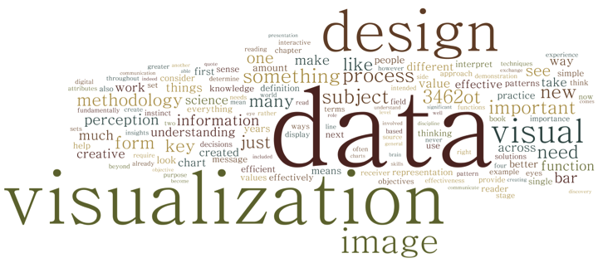
Power of Data Visualization
Notes:
Power of data visualization is to provide creative means to present information, identify patterns in a simple way.

Slide 16
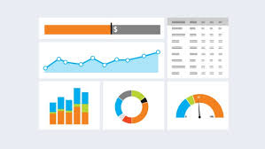
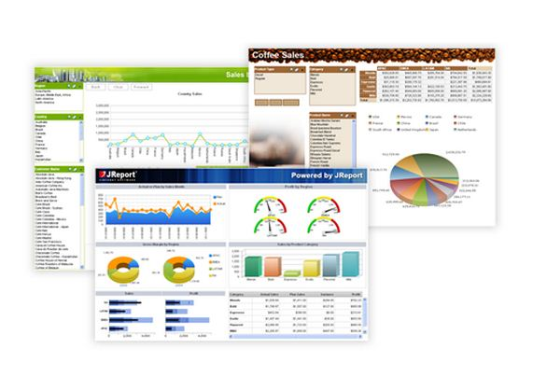
Dashboards

Slide 17
Measures vs Dimensions
Mental Health Profile, Canadian Community Health Survey
Ref_Date | GEO | AGE | SEX | INDICATOR | UNIT | Value
2012 | Canada | 15 to 24 years | Males | Any mood disorder, life | Number of persons | 258281
2012 | Canada | 15 to 24 years | Females | Any mood disorder, life | Number of persons | 306894
2012 | Canada | 25 to 44 years | Males | Any mood disorder, life | Number of persons | 513122
2012 | Canada | 25 to 44 years | Females | Any mood disorder, life | Number of persons | 756901
2012 | Canada | 45 to 64 years | Males | Any mood disorder, life | Number of persons | 495086
2012 | Canada | 45 to 64 years | Females | Any mood disorder, life | Number of persons | 845135
2012 | Canada | 65 years and over | Males | Any mood disorder, life | Number of persons | 121964
Dimensions
Unit of the
Measure
Measure
Contains information licensed under the Open Government Licence – Canada.

Slide 18
Measures vs Dimensions
Mental Health Profile, Canadian Community Health Survey
Dimension | Measure
Any mood disorder, all sexes, 65+ age | Total Number of People
All Provinces | Count of Distinct Indicators
Any mood disorder/province, all sexes, 15+ | Average Number of People
Contains information licensed under the Open Government Licence – Canada.

Slide 19
Measures vs Dimensions
Measures are numeric and can be aggregated : Sum, Average, Maximum, Count…
The dimension is what you “slice and dice” the measure by. Selecting dimension brings the context to the measure

Slide 20
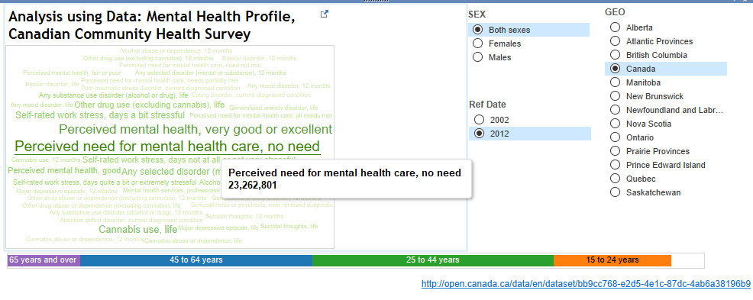
Dashboard
Notes:
Walk through the measure and dimension on the dashboard

Slide 21
Creating Dashboards
Simple, communicates easily
Minimum distractions...
Visual presentation of performance measures
Ability to identify trends
Measure efficiencies/inefficiencies
Align strategies and organizational goals
Saves time compared to running multiple reports
wikipedia

Slide 22
DEMO

Slide 23
DEMO
Go to github.com/uzmaali -> Data Visualization Workshop
Download Tableau Public (Free) or Tableau Desktop 10 (Trial)
Download Mental Health Profile, Canadian Community Health Survey - Mental Health (CCHS) dataset
  http://open.canada.ca/data/en/dataset/bb9cc768-e2d5-4e1c-87dc-4ab6a38196b9
wikipedia

